Slide 1
First data with test of SiPM KETEK 25μm
Raw waveforms were saved in csv files and then converted to txt files.
A self-written ROOT scritps are used for the further analysis.
The anaylsis is very naïve with the aim to test the ability of analyzing the saved data.
All histograms presented are reproduced by the self-written programs.

Slide 2
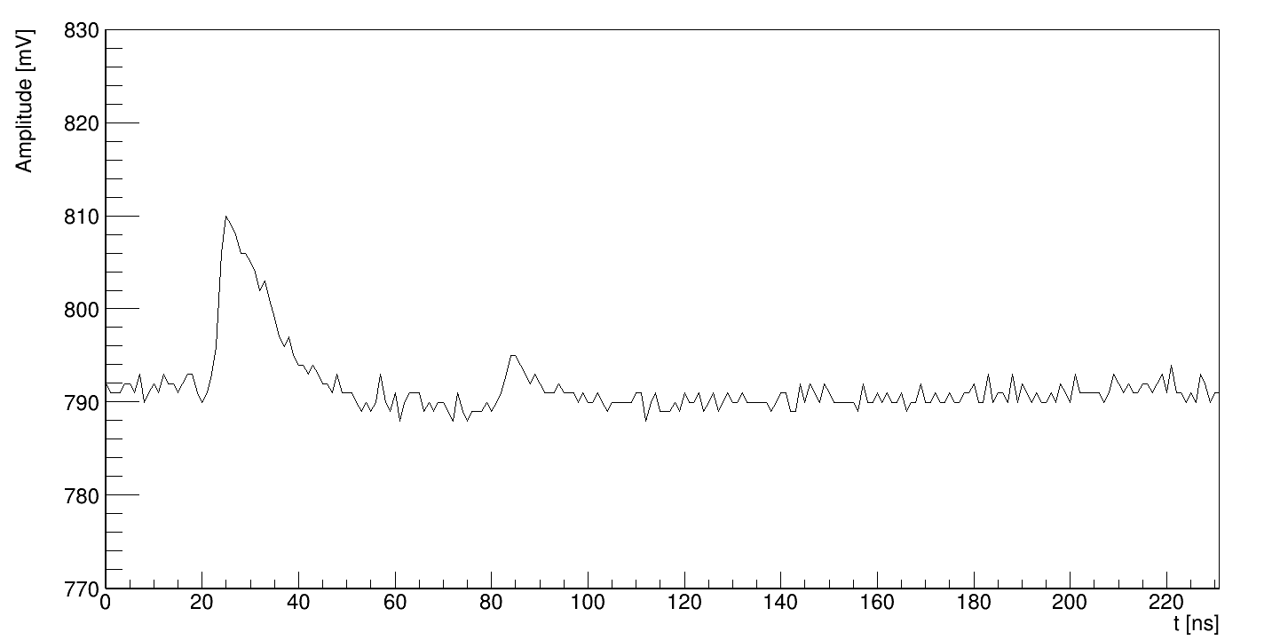
An Example of a waveform
It seems that the SiPM output signal is still very fast, we might need to use different pre-amplifier
with larger bandwidth!!

Slide 3
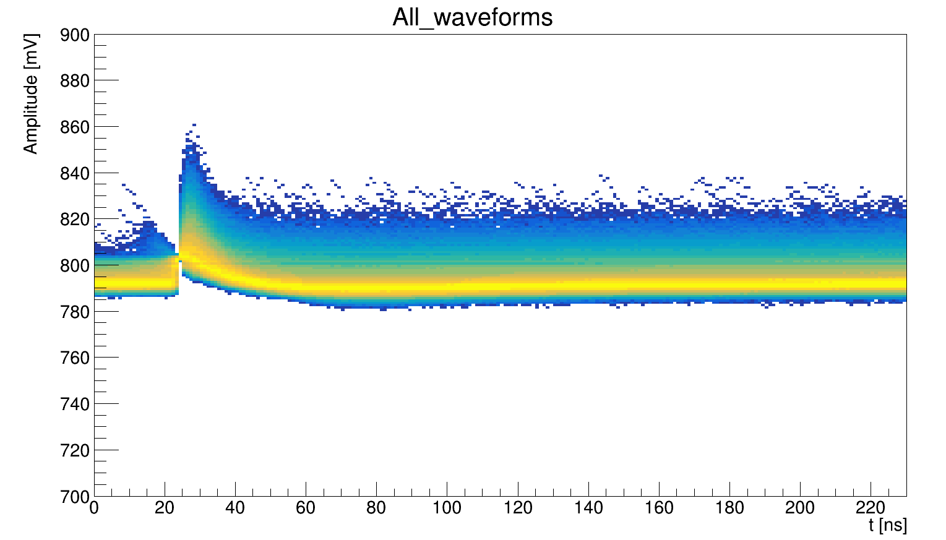
2D plot for all waveforms
The SiPM output charge was “simply” calculated by subtracting the integrated amplitudes in a fixed window around the signal from the average_baseline. The average baseline was calculated by the
integrated amplitude of the first 18 ns window divided by 18.
BaseLine window
for ave_BL calculation
Signal window
for Q calculation

Slide 4
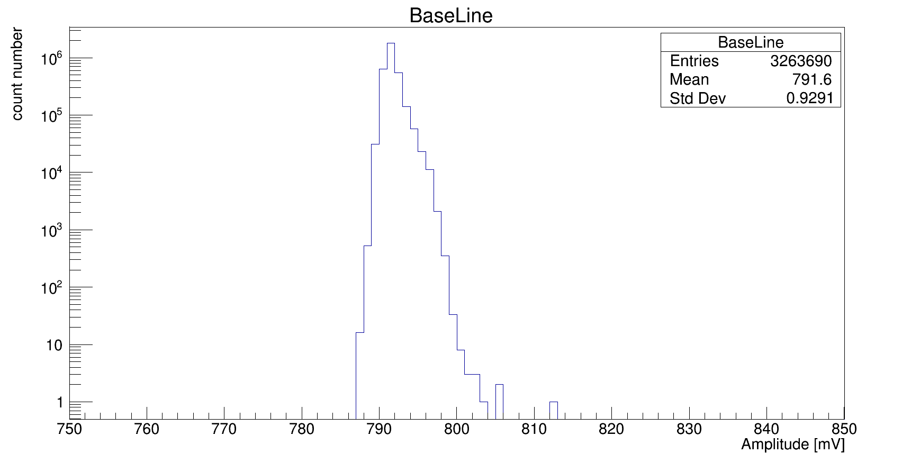
The average baseline

Slide 5
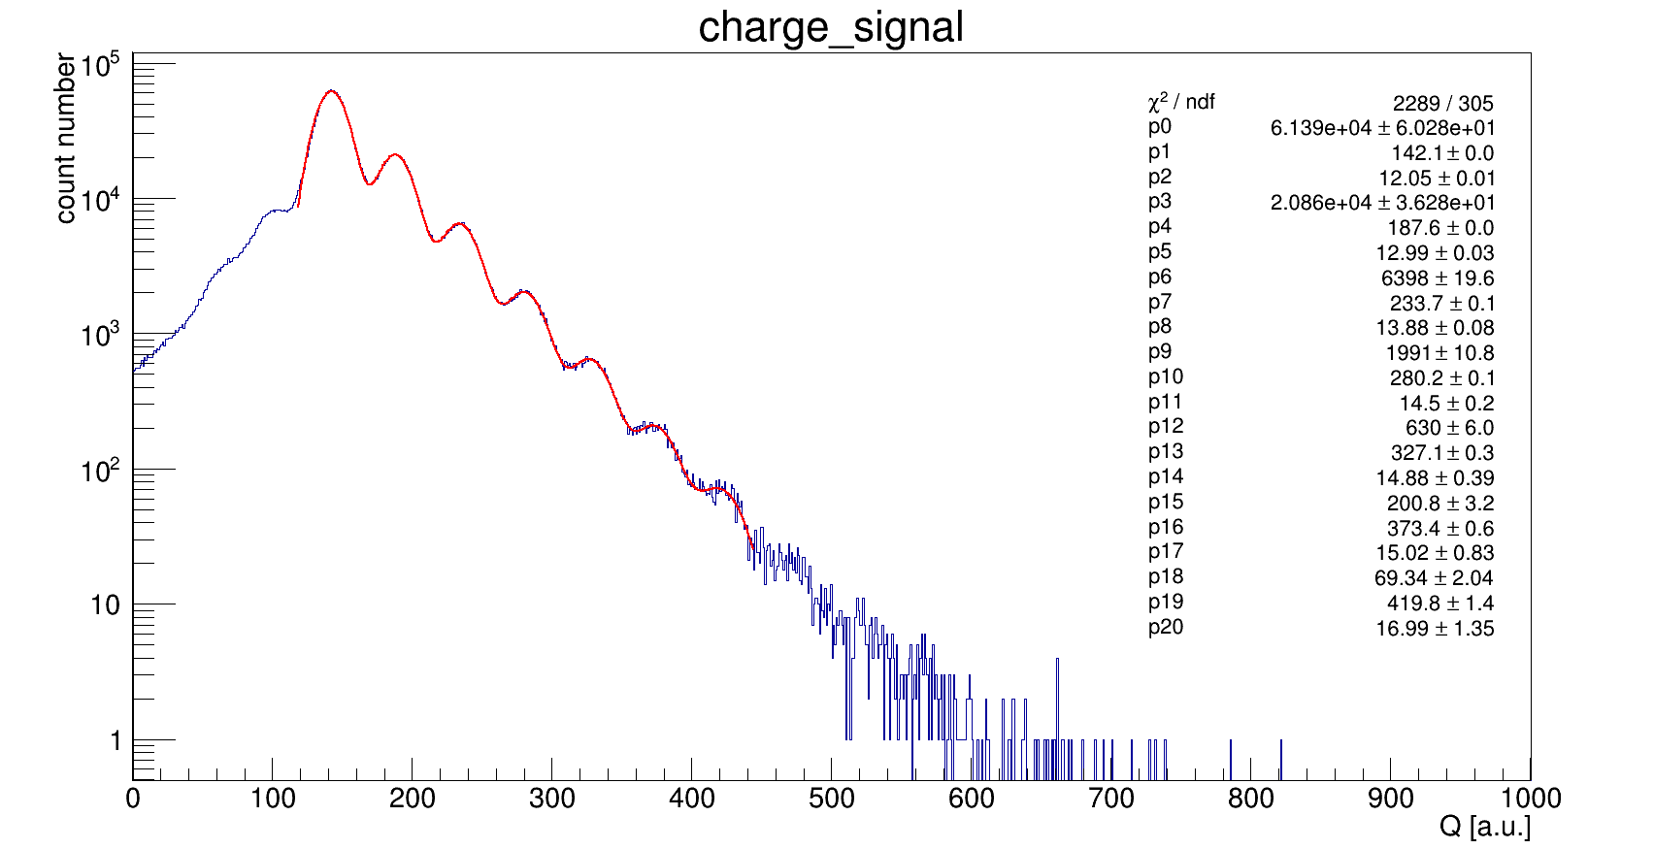
The charge spectrum of the output signal of KETEK 25μm.
1 p.e.
2 p.e.
3 p.e.
4 p.e.
5 p.e.
6 p.e.
7 p.e.
The multi p.e. Peaks are ﬁtted with a sum of independent Gaussian functions

